Slide 1

ASP.NET MVC Core

Slide 2

Who am I?
I am the Founder and President / CTO of Mindfire Technology
We are a Tech company, not a HR company
http://www.MindfireTechnology.com
I am a founding member of Utah Geek Events
Provides training for professionals
Utah Code Camp, Big Mountain Data, Launch Events, etc.
http://www.UtahGeekEvents.com
I am the Co-President of Northern Utah .NET Users Group (NUNUG)
http://www.nunug.org
I have been writing software professionally for the past 20+ years
As a consultant, I've worked with dozens of different companies
I've architected massive-scale projects
Notes:
I like to write clean code!
I like to teach others how they can do the same!

Slide 3


Slide 4
What is .net Core?
Free Open Source Software (FOSS) @ (https://github.com/dotnet/core)
Self contained, doesn't require a framework to be pre-installed
Multi-Platform (Windows, macOS, Linux)
Multi-Architecture (x86, x64, ARM, ARM64)
Uses Roslyn, a next-generation compiler
Includes a majority of the libraries that are part of the full framework

Slide 5
The "Core" Approach
Extremely Light!
Everything is a dependency, even the compiler
Everything is modular, even the base class library
Extremely Fast!
Platform optimized JIT compiler (RyuJIT)
Frequently Updated!
Multiple releases per year

Slide 6
.NET CORE VS STANDARD VS FRAMEWORK
.NET Standard is just a specification, not an actual framework
Replaces PCL (Portable Class Libraries)
.NET Core
.NET Standard
.NET Framework
Mono

Slide 7
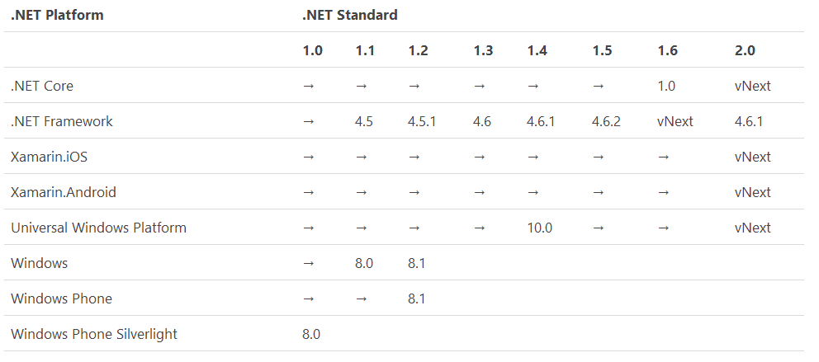
.NET Standard

Slide 8
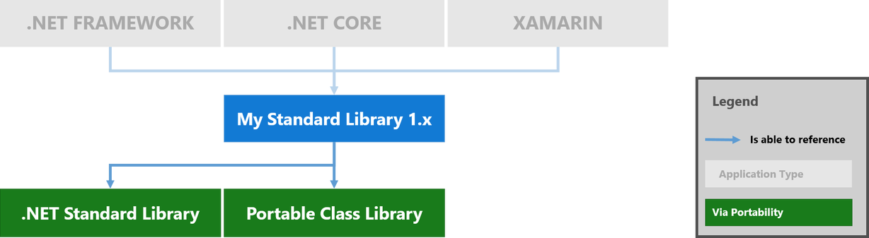
.NET Core 1.0

Slide 9
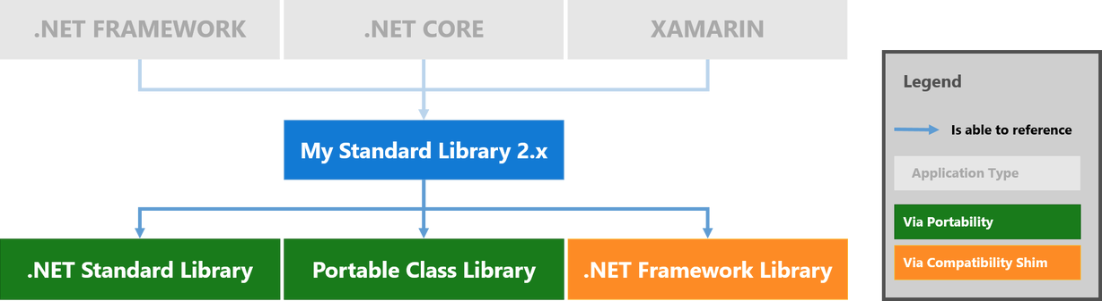
.NET CORE 2.0

Slide 10
Why?
Why do we need another framework?
Why do we have .NET core and the .NET Framework
Why not just use Mono?
Why use C# over other cross-platform languages?

Slide 11
Starting Over
The way we deploy apps is changing:
Apps are becoming more containerized and cloud-based
Need lighter (or no) platform dependencies
More modularity
Performance demands continue to increase – CPU clock speeds remain steady
Notes:
We expect to build Microservices and Core makes that easier
Modularity means that less of the bits of code we don't use in our app need to be present.
It also means that different portions of the framework can be fixed, deployed, updated, swapped, etc. as needed.
We need to scale out rather than scale up

Slide 12
What's Missing
Cross Platform UI
XWT
GTK#
Wx.NET
Qyoto (port of QT)
Eto.Forms (Xamarin-forms-like Native)
Platform Specific Features
Notes:
Currently, it only supports UWP

Slide 13
What can I use it for Today?
Console Applications
Web Applications
Universal Windows Platform (UWP)
Cross Platform Libraries (.NET Standard)

Slide 14
Why use .NET Core?
FOSS software built on ECMA standards
C# and F# are Great Languages!
More standardized stack
Fast! Faster than .NET Framework
Cross Platform
AOT Compilation
Docker Support
No platform dependencies
Most portable class libraries

Slide 15
C# is really Awesome!
Type-safe but still flexible
Security of Managed Code
Had the benefit of fixing the mistakes of Java, etc.
Versatile – Useful for many different kinds of applications
Elegant mix of Object Oriented and Functional styles makes for clean readable code
Excellent Developer Experience

Slide 16
Demo 1 - .NET Core Console Application
Where to get .NET Core
How to create a new project
Hello World

Slide 17
Demo 2 – ASP.NET Core Application
Project Setup
Project Structure
Dependency Injection
MVC
Notes:
Create new Project (dotnet new mvc)
Walkthrough structure (Program.cs / Startup.cs)
Walkthrough MVC
Router
Controller
View
ModelBinder
Hook into the DI with our CS file
Create a new controller
Test with a GET request
Create a view
Environment Tags
Input Tags
Postback (round trip)

Slide 18
Questions?

Slide 19
Thanks!
Slides and Demo available at: http://github.com/NUNUG/ASPNETCorePresentation

Slide 20
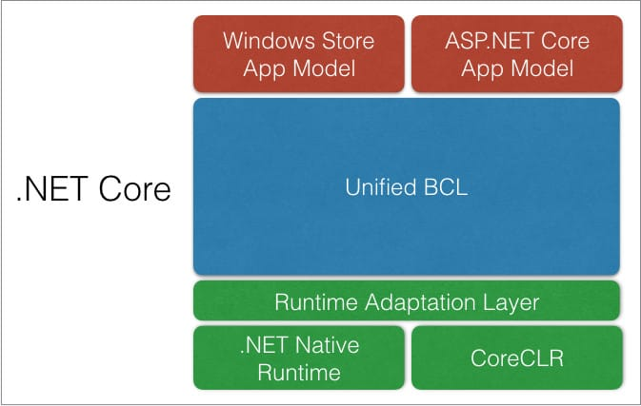
.NET COre Architecture

Slide 21
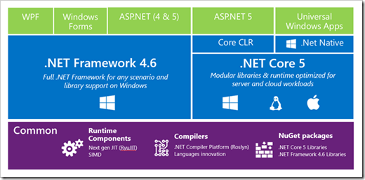
.NET CORE VS STANDARD VS FRAMEWORK

Slide 22
